Slide 1
Electromagnetic Induction

Slide 2
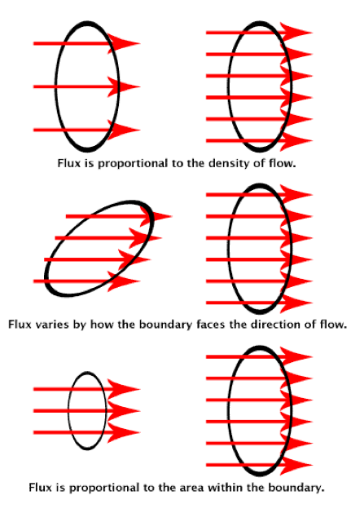
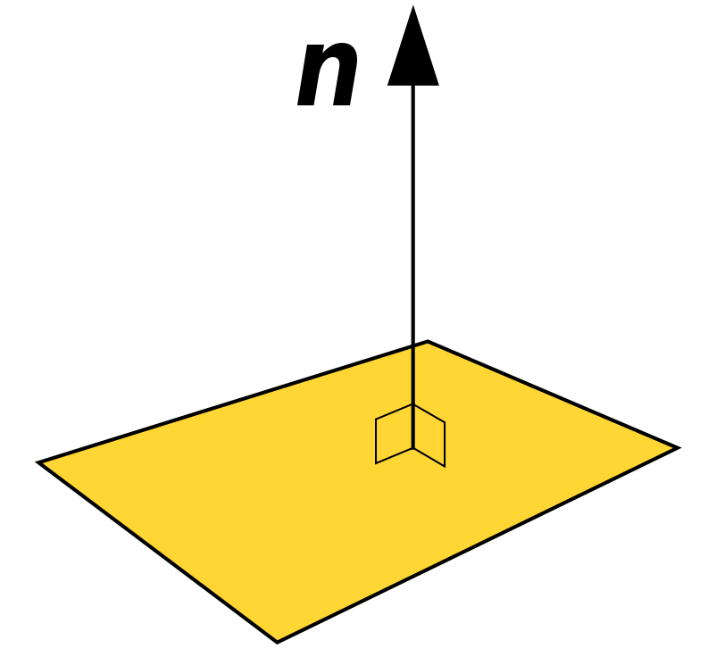
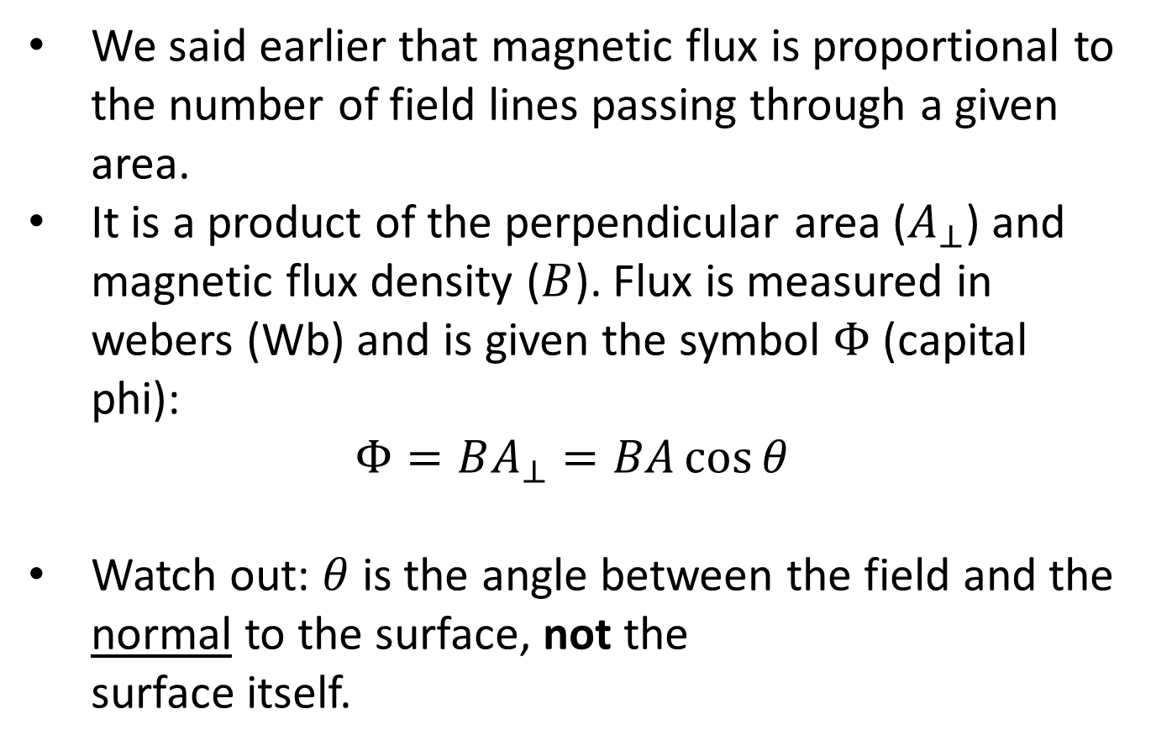
Magnetic Flux
We said earlier that magnetic flux is proportional to the number of field lines passing through a given area.
It is a product of the perpendicular area ($A_{⊥}$) and magnetic flux density ($B$). Flux is measured in webers (Wb) and is given the symbol $Φ$ (capital phi):
$$Φ=BA_{⊥}=BA\cos{θ}$$
Watch out: $θ$ is the angle between the field and the normal to the surface, not the surface itself.
Notes:
The word ‘flux’ describes the process of flowing (hence the word ‘influx’), which is a helpful way of thinking about it. How much magnetic field is flowing through the area?
Weber is usually pronounced the way it looks, but it’s named after a German physicist who would have pronounced it VAY-ber.
https://youtu.be/6T7aG3Gd_38 provides a nice quick summary of this with some helpful visuals.

Slide 3
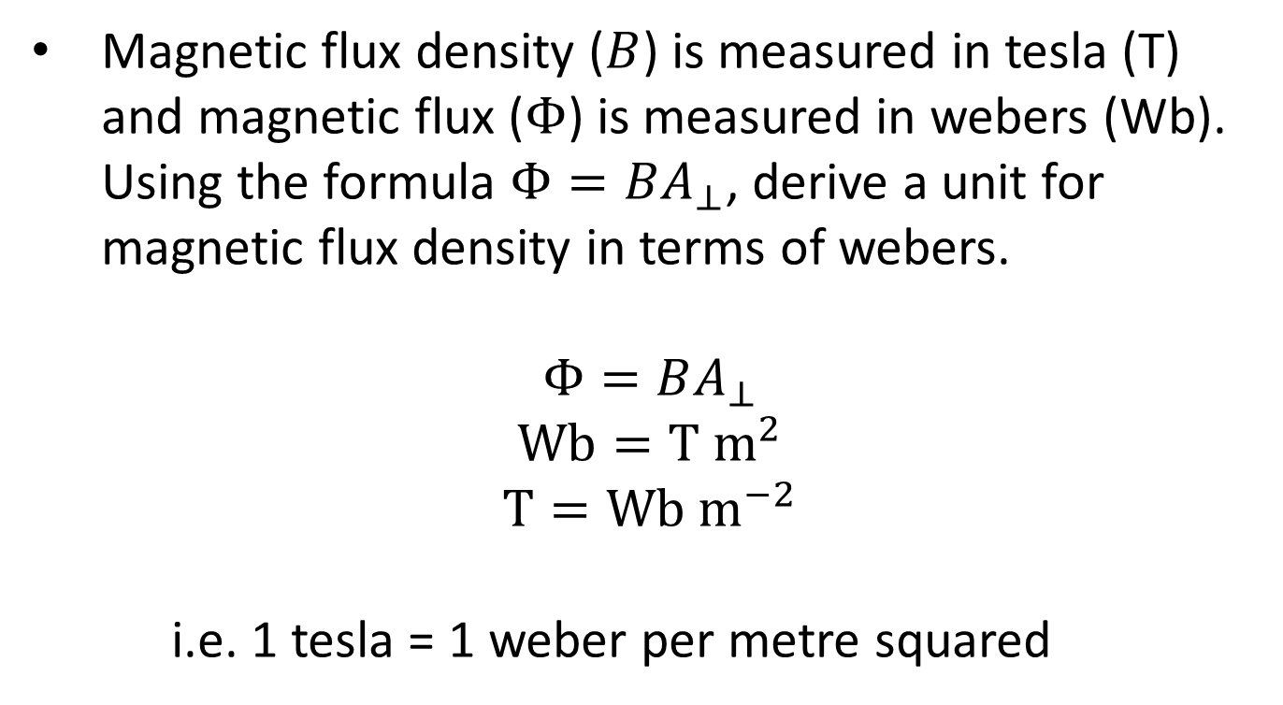
Example #1
Magnetic flux density ($B$) is measured in tesla (T) and magnetic flux ($Φ$) is measured in webers (Wb). Using the formula $Φ=BA_{⊥}$, derive a unit for magnetic flux density in terms of webers.
$$Φ=BA_{⊥}$$
$$\text{Wb}=\text{T} {\text{m}}^{2}$$
$$\text{T}=\text{Wb} {\text{m}}^{−2}$$
i.e. 1 tesla = 1 weber per metre squared
Notes:
This makes sense of the ‘density’ part of magnetic flux density: asking how much flux (flow) there is in each square metre is very similar to asking how much mass there is per unit of volume.

Slide 4
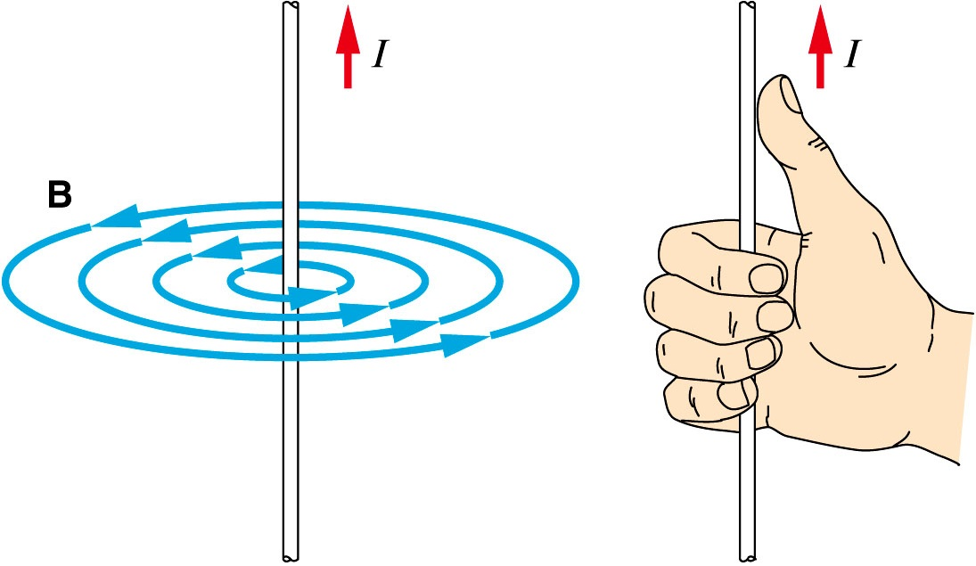
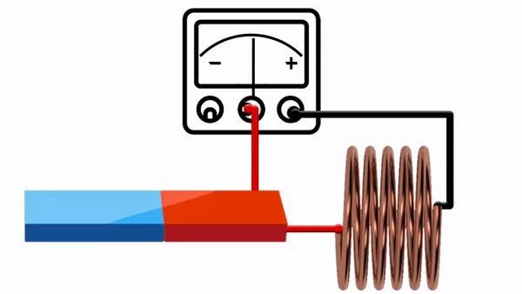
Electromagnetic Induction
Previously we saw that a current can produce a magnetic field.
In 1831, Michael Faraday discovered that the opposite is also true: a magnetic field can produce a current.
Specifically, a changing magnetic field will induce a current in a conductor. This current is produced by an induced electromotive force (emf).
Side note: emf isn’t actually a force: it describes energy transfer to a circuit. Emf can often be used interchangeably with voltage, and is even measured in volts, but strictly speaking the two are not the same.
Notes:
Side side note: the ISO and IEC have deprecated emf in favour of the term source voltage, which they’ve assigned the symbol U_{s}.
https://www.electricalclassroom.com/difference-between-emf-and-voltage/ provides a great comparison if you want to investigate further, but at this level you can totally get away with treating the two as the same.

Slide 5
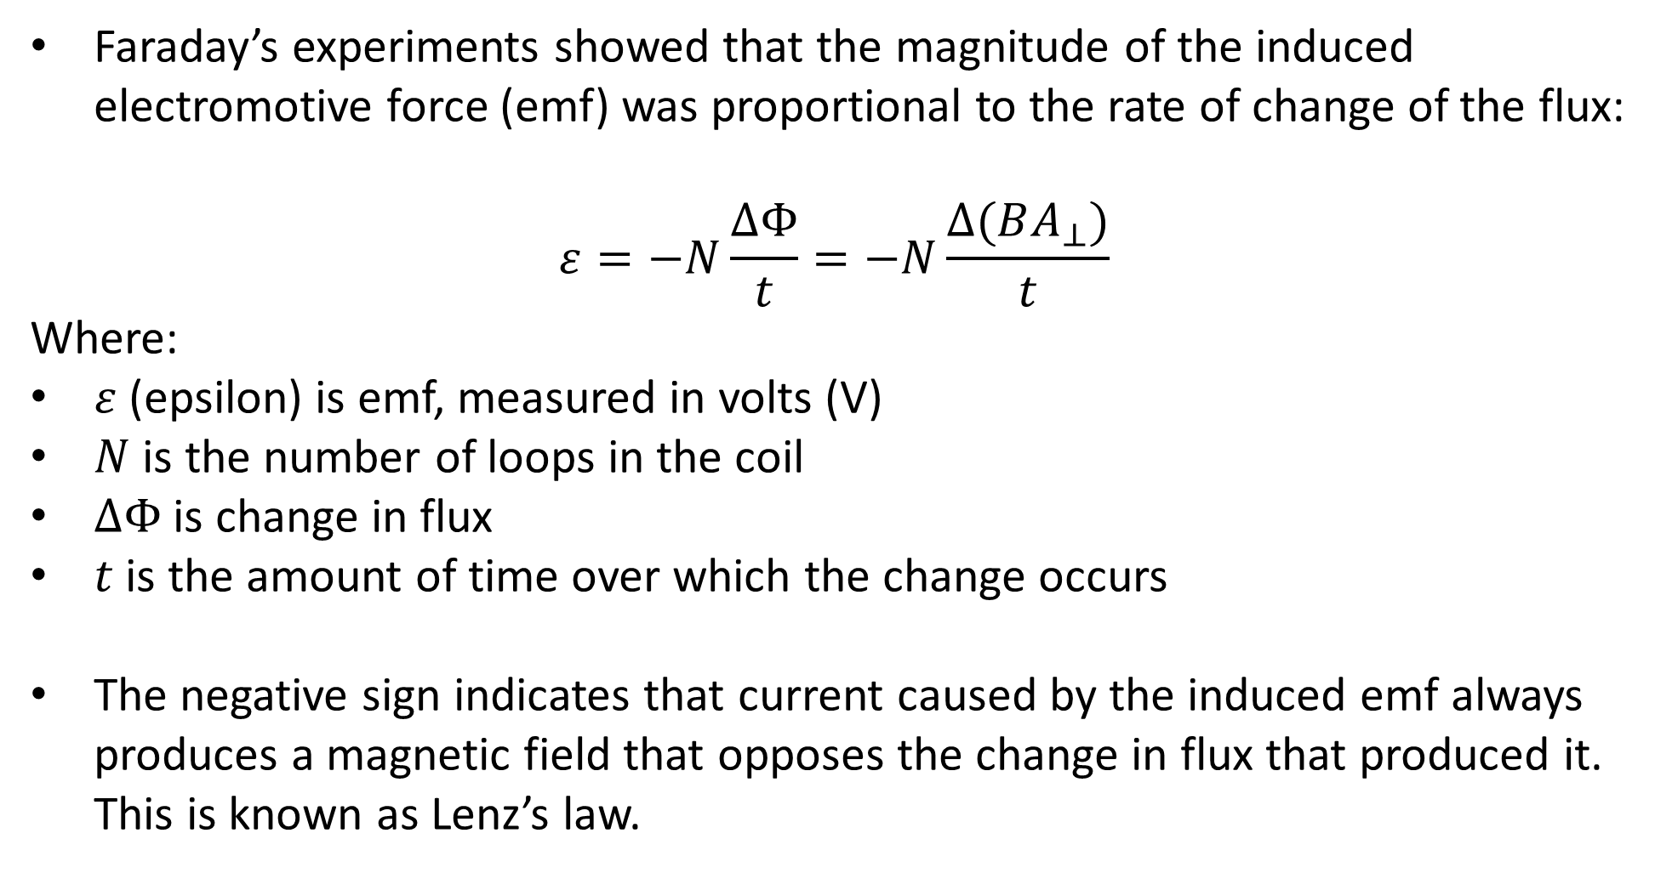
Electromagnetic Induction
Faraday’s experiments showed that the magnitude of the induced electromotive force (emf) was proportional to the rate of change of the flux:
$$ε=−N\frac{ΔΦ}{t}=−N\frac{Δ(BA_{⊥})}{t}$$
Where:
$ε$ (epsilon) is emf, measured in volts (V)
$N$ is the number of loops in the coil
$ΔΦ$ is change in flux
$t$ is the amount of time over which the change occurs
The negative sign indicates that current caused by the induced emf always produces a magnetic field that opposes the change in flux that produced it. This is known as Lenz’s law.

Slide 6
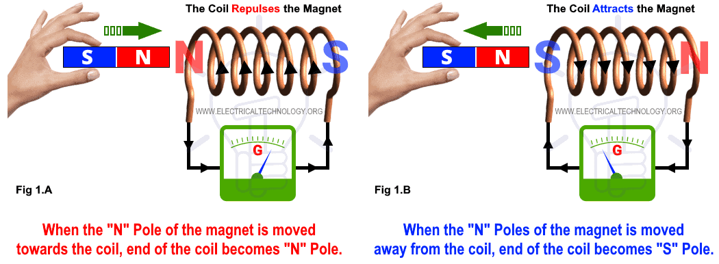
Lenz’s Law

Slide 7
Eddy Currents
A changing magnetic field can even produce small, circular currents in a conductor that is not part of a circuit. These localised currents are known as eddy currents.
Eddy currents always flow in planes perpendicular to the magnetic field.

Slide 8

Notes:
https://youtu.be/k2RzSs4_Ur0

Slide 9
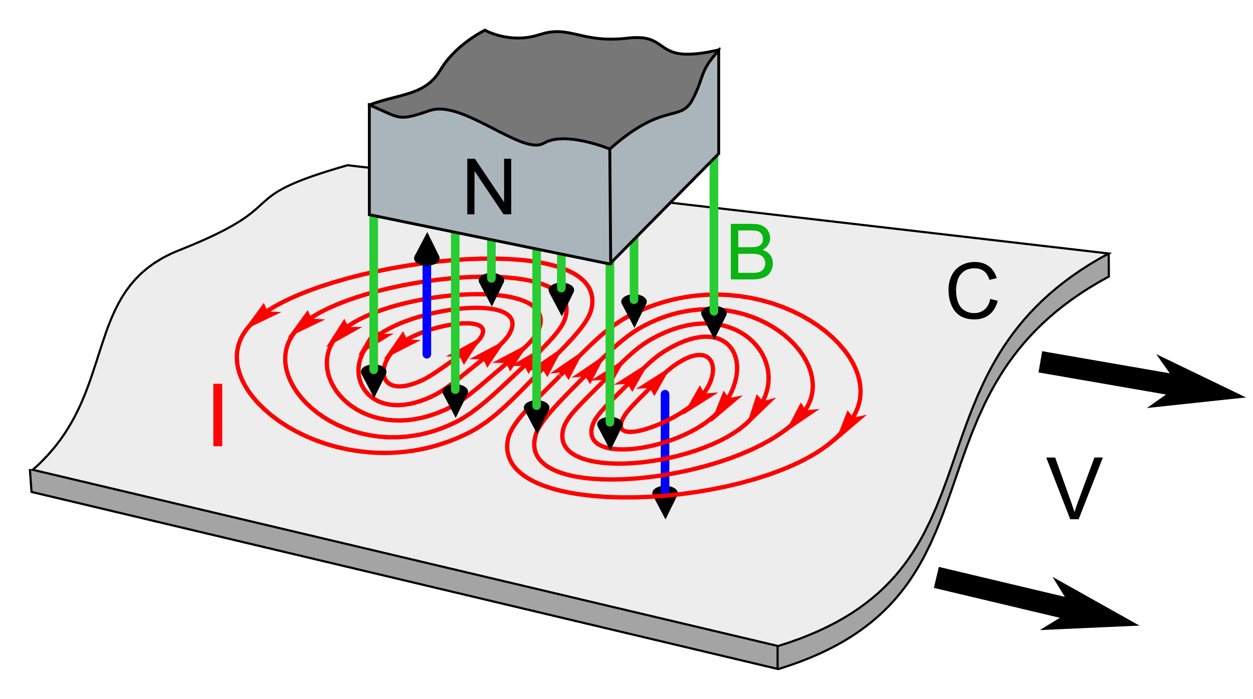
Example #2
The diagram below shows eddy currents (I) produced in a conductor (C) as it is moved under a magnet producing magnetic field B.
In simple terms, what effect will this have on the velocity (V) of the conductor?
What do the blue arrows represent?
Why are two different sets of eddy currents produced?
Are the directions of the blue arrows correct? Explain why or why not.

Slide 10
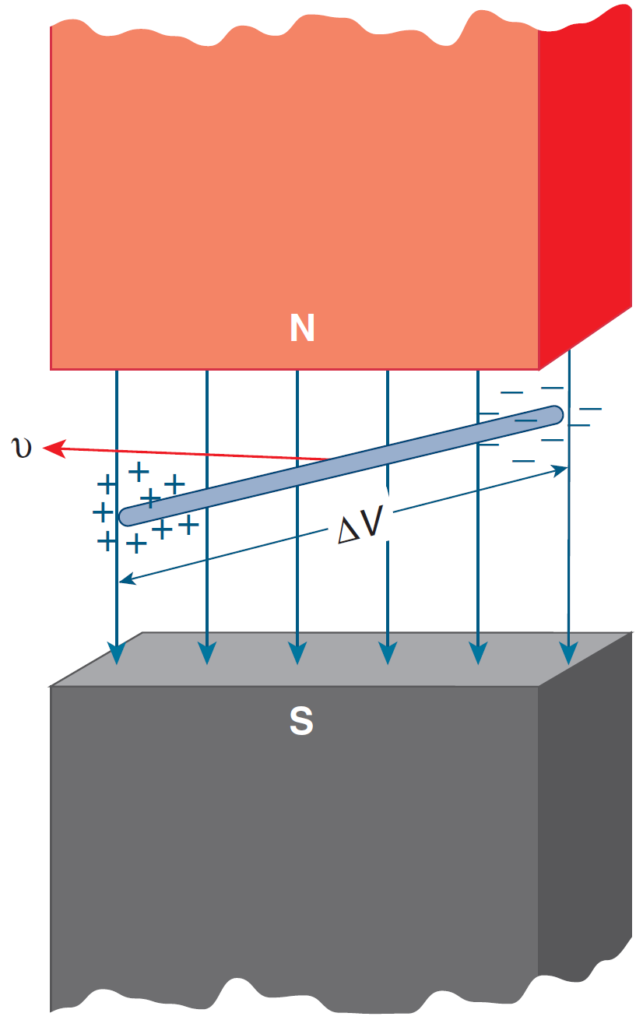
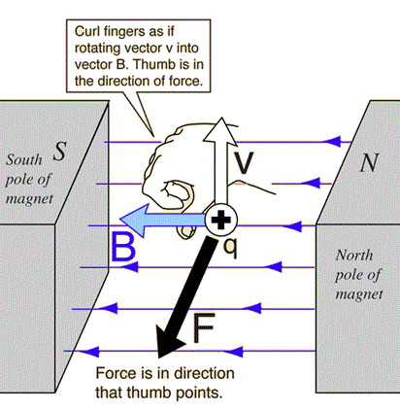
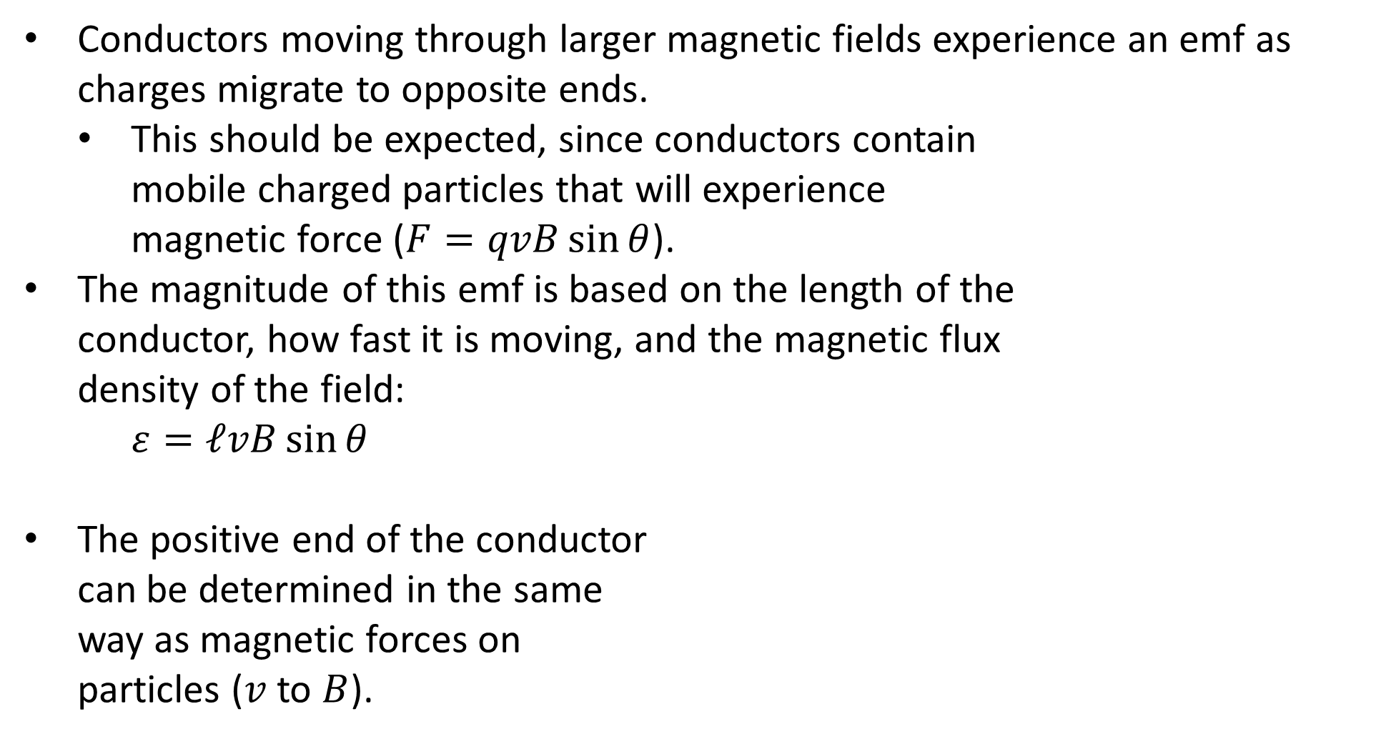
Emf in a Moving Conductor
Conductors moving through larger magnetic fields experience an emf as charges migrate to opposite ends.
This should be expected, since conductors contain mobile charged particles that will experience magnetic force ($F=qvB\sin{θ}$).
The magnitude of this emf is based on the length of the conductor, how fast it is moving, and the magnetic flux density of the field:
$ε=ℓvB\sin{θ}$
The positive end of the conductor can be determined in the same way as magnetic forces on particles ($v$ to $B$).

Slide 11
Example #3
As an aeroplane flies along through the Earth’s magnetic field, its wings act much like a straight wire.
At which places on the Earth will the induced emf across an aeroplane’s wings be maximum?
What is the maximum emf which would be induced across the wings of a Boeing 747 with a wing span of 64.0 m, flying at 990 km h^{–1} through the Earth’s magnetic field? Take the maximum magnitude of the Earth’s magnetic field as 60.0 μT.

